Slide 1


Slide 2


NOVEL WEB
GROUP 19

Slide 3

Table of contents
Introduction
Overall description
Detailed Requirement
Supplementary Specification
References
3

Slide 4

Introduction
This web application provides an online library for sharing and reading novels.
Users can read many famous novel for free or with a VIP membership.
5

Slide 5
Actors
User: user are people who are interested in using website to read their novel online. They can do many things on the websites such as add new novels to their favorite lists, search for a particular novel, read the novel, rate a novel or comment on a novel
VNPAY system: It plays a critical role in executing transaction between user and the Novel website. Whenever a user want to upgrade to VIP membership, they are asked to perform a transaction on VNPAY.
Administrator: Admins are responsible for managing users, items in the database.
6

Slide 6

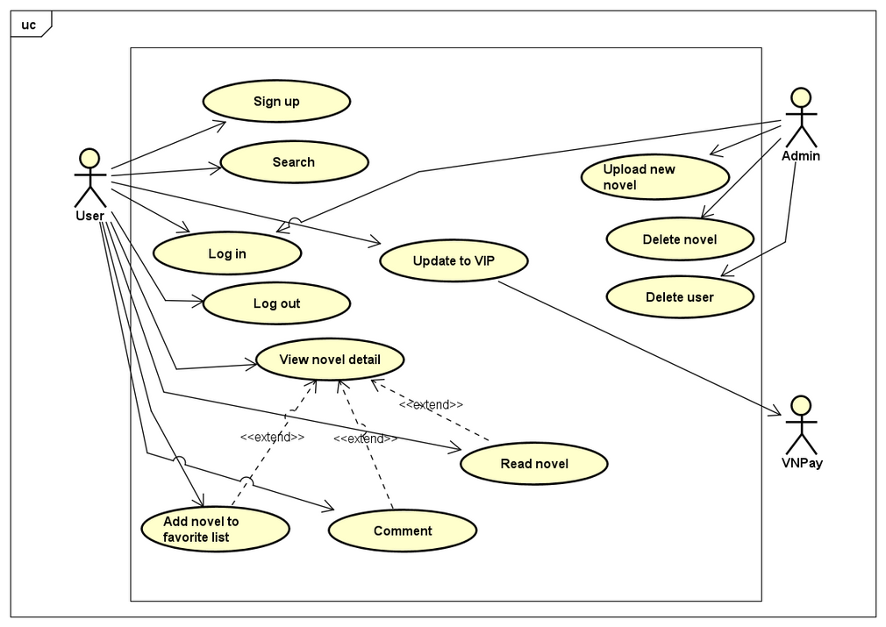
Use case Diagram
7

Slide 7
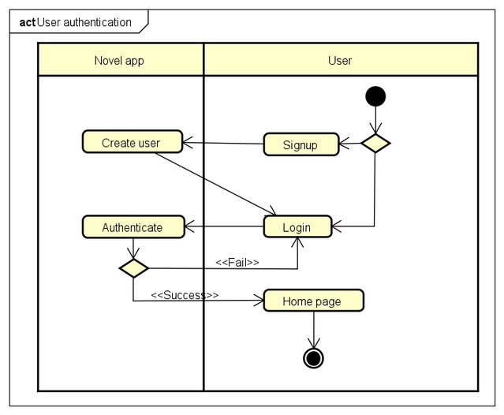
Activity Diagram - User Authentication
8

Slide 8
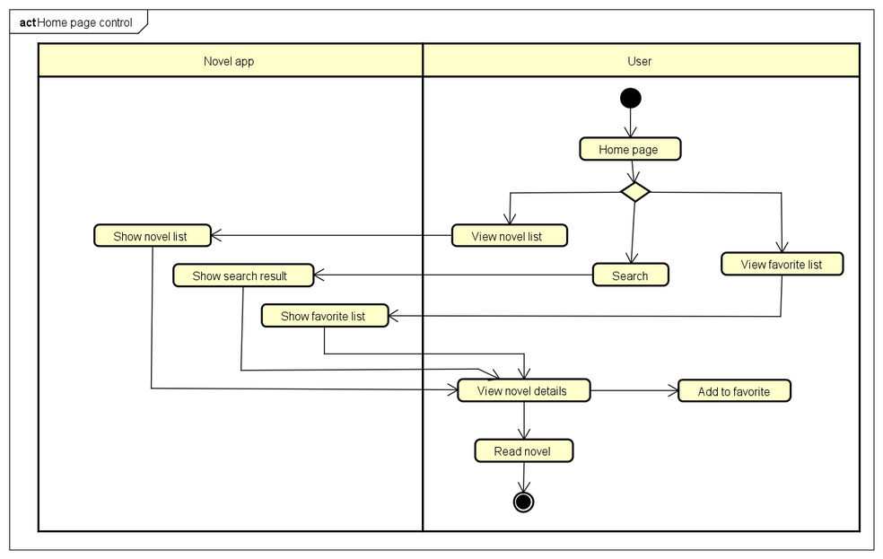
Activity Diagram - Home Page Control
8

Slide 9
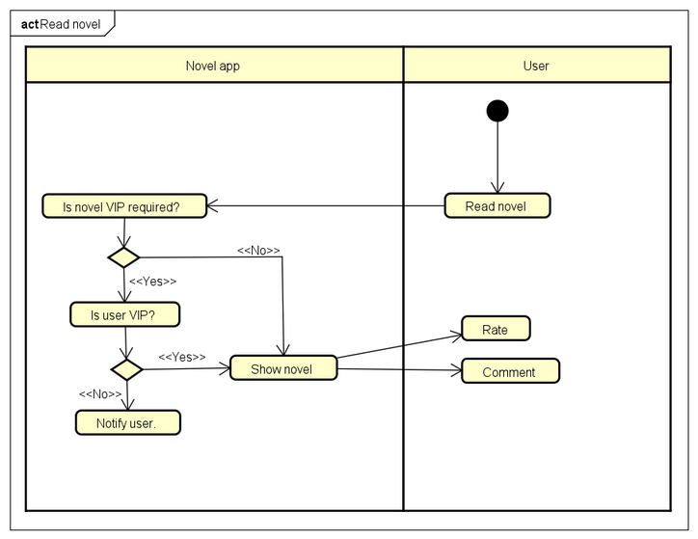
Activity Diagram - Read Novel
8

Slide 10
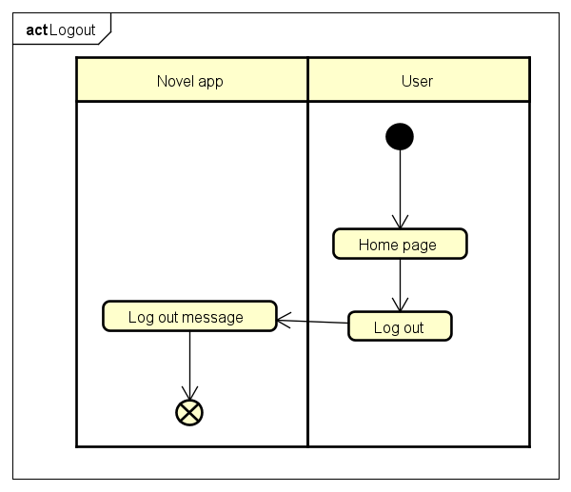
Activity Diagram - Logout
8

Slide 11
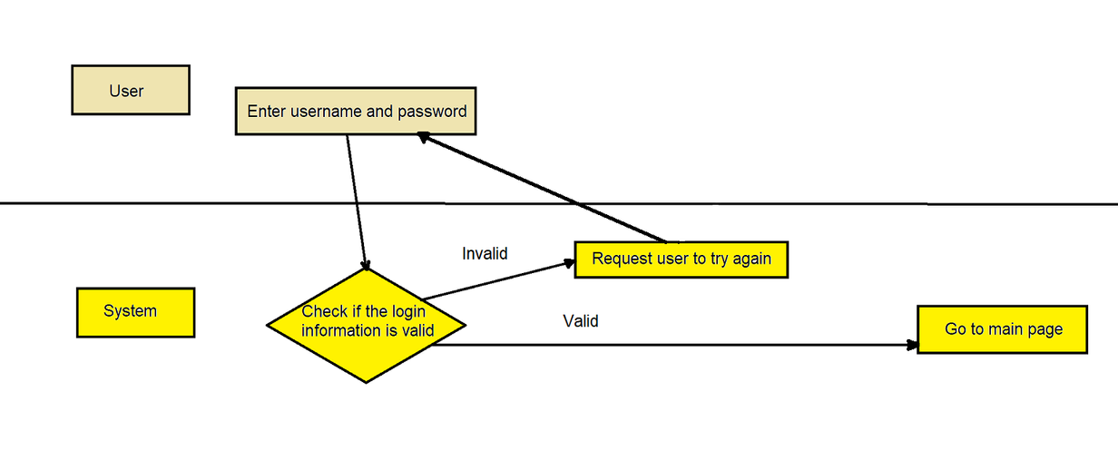
Detailed Requirement - Use Case "Login"
Use case code: UC001
Brief Description: describe the interaction between user, Novel website when user wants to login to their account
5

Slide 12
Detailed Requirement - Use Case "Read Novel"
Use case code: UC002
Brief Description: describe the interaction between user and Novel website when user wishes to read a novel
Actor: User and Novel website
5

Slide 13
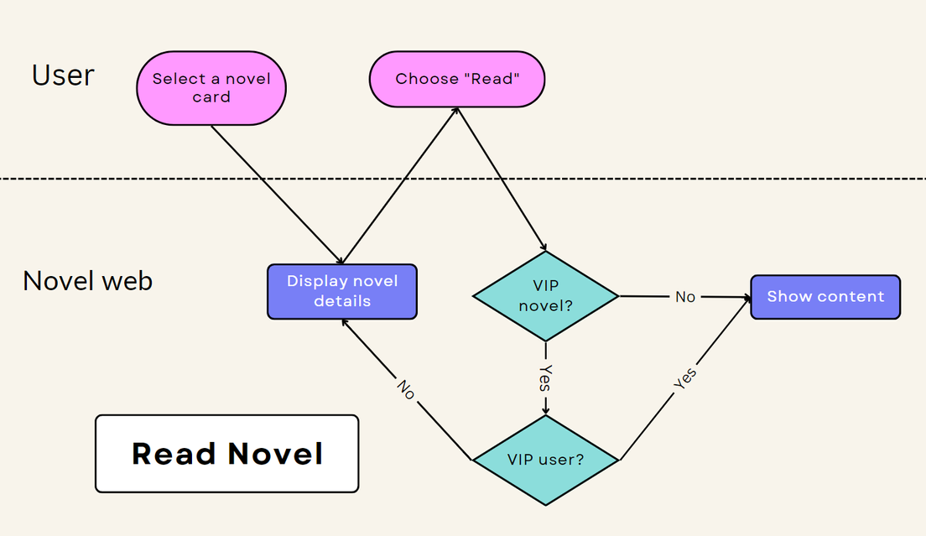
Detailed Requirement - Use Case "Read Novel"
Flow of Event:
5

Slide 14
Detailed Requirement - Use Case "Upgrade to VIP"
Use case code: UC003
Brief Description: describe the interaction between user, Novel website and the VNPay system when user wants to upgrade to VIP membership
5

Slide 15
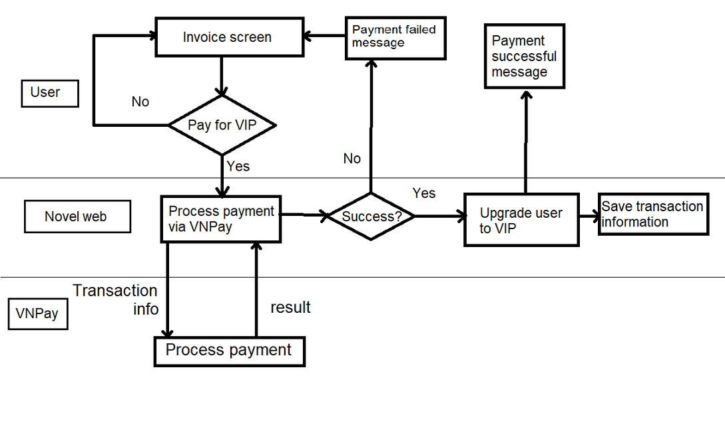
Detailed Requirement - Use Case "Upgrade to VIP"
Flow of Event:
5

Slide 16

THANK YOU !
9

